Slide 1



Unit 7: Tourism
Lesson 7B: GRAMMAR

Slide 2

Ex 1: Read the postcards, identify the places. cities and countries.

Slide 3
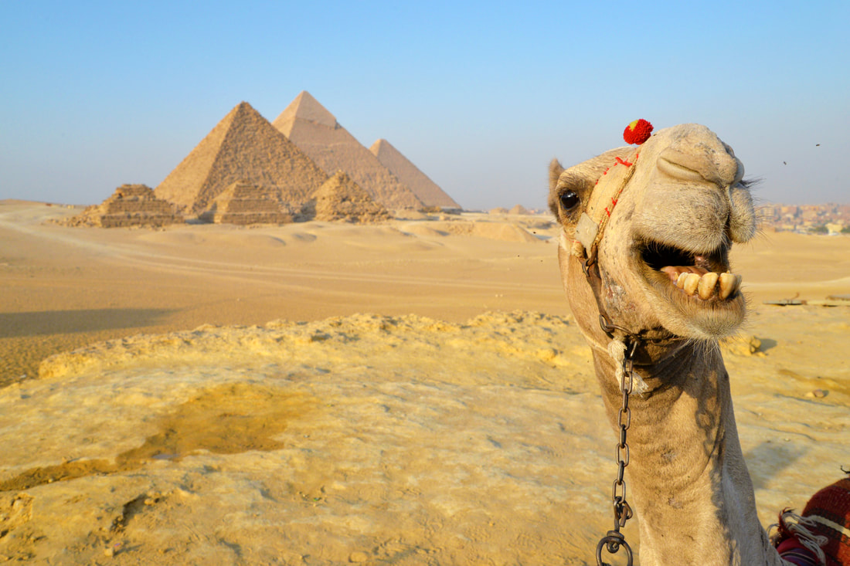
Pyramid - Cairo - Egypt
Dear Deb, I am writing from Cairo! This place is absolutely bonkers but I really, really love it. So far I have ridden a horse around the pyramids, tried a boat ride on the Nile, visited the Valley of the Kings in Luxor—that place was awesome but it was 115 degrees there by noon so all we did was lie by the pool! This weekend I am going to go snorkeling in the Red Sea which should be really fun!
How is school going? I hope you are doing well! Take care of yourself! Bye!
Love,
Sarah “Goddess of the Nile”
SHOW

Slide 4
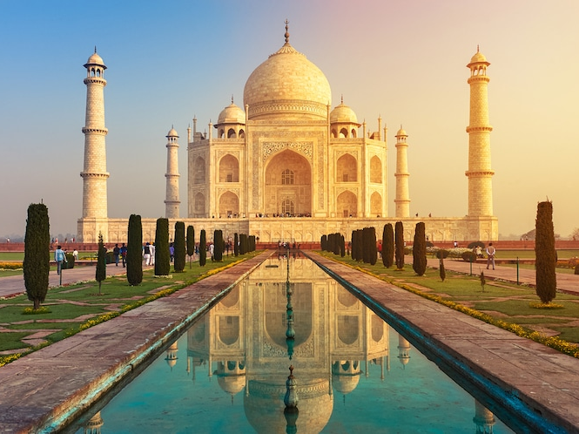
Taj Mahal - Agra - India
Hi Fiona,
India is incredible! There are so many different places and things to see. The elephants at Agra were beautiful with colours painted over their bodies. I had a ride on a lovely lady.
Today I visited the Taj Mahal. It was all I expected, beautiful.
It is incredible and a beautiful work of art.
I hope you like the postcard. I will send another at our next stop.
Bye
Emma
SHOW

Slide 5
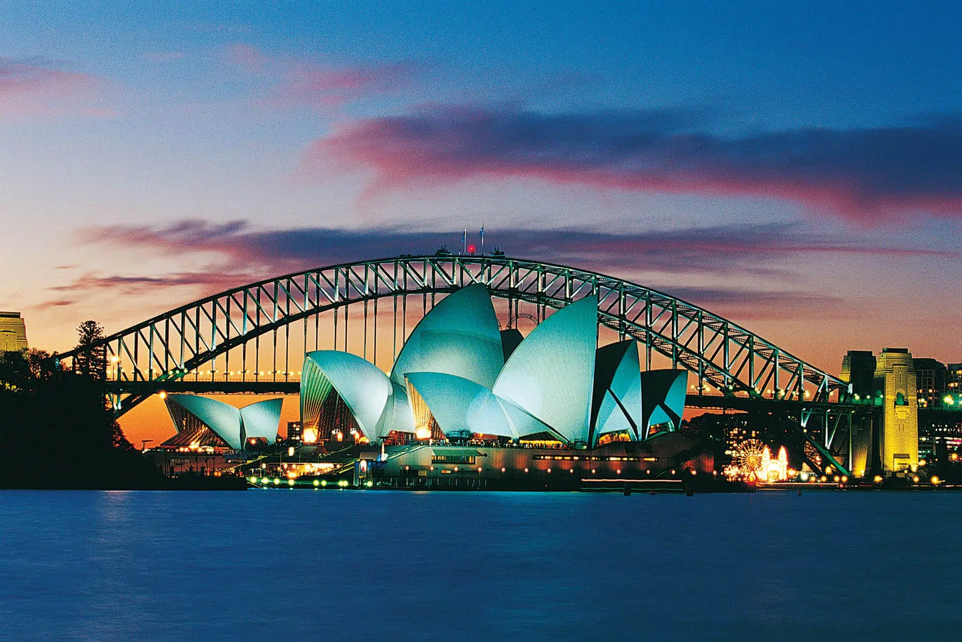
Opera House - Sydney - Australia
Dear Trang,
I am visiting Sydney in Australia. It is internationally known for its beautiful beaches and architecture: the Sydney Opera House. The iconic opera house is located in Sydney Harbor- the largest financial centre . It serves as a venue for several types of performing arts besides opera, including theater and piano performances, among other arts. I really like Sydney city.
Love,
Minn.
SHOW

Slide 6
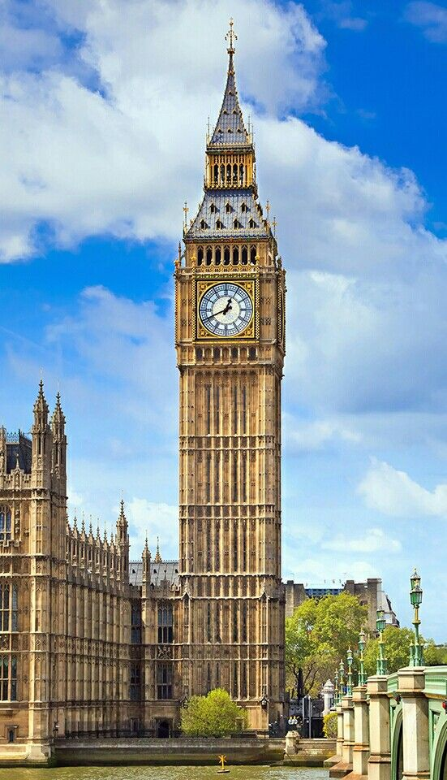
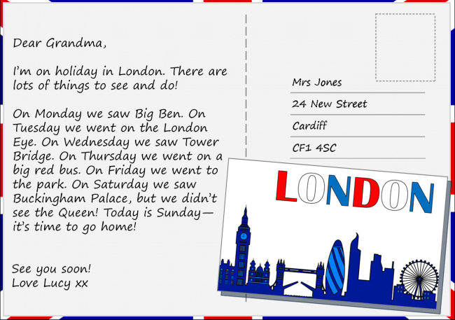
Big Ben Clock Tower - London - England
SHOW

Slide 7
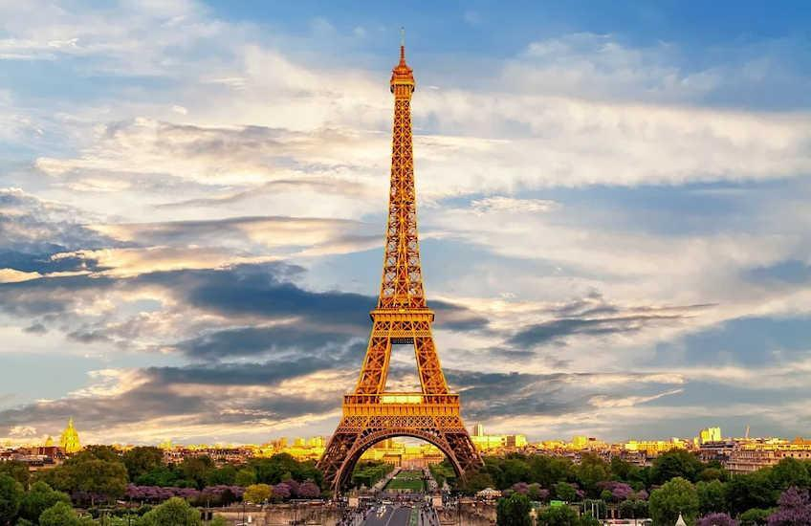
Eiffel Tower – Paris - France
Dear Santos, Paris is always as charming and awesome as ever. I wish you were here for a croissant and coffee. I just got back from visiting the museums, trying to seek out the best views of the sacred places from different angles. It was truly a mesmerizing experience to visit Eiffel tower. And guess what, it is 330m high! Your pal, Charlie
SHOW

Slide 8
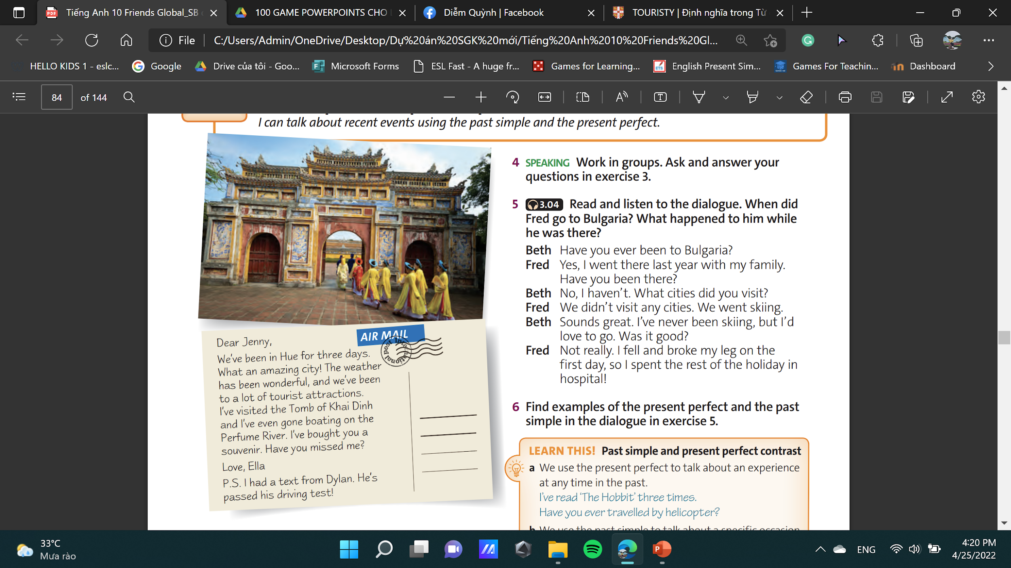
Tomb of Khai Dinh - Hue - Vietnam
SHOW

Slide 9
GRAMMAR
7B
PRESENT PERFECT
PAST SIMPLE
I can talk about recent events using the past simple and the present perfect.
Student Book- page 84

Slide 10
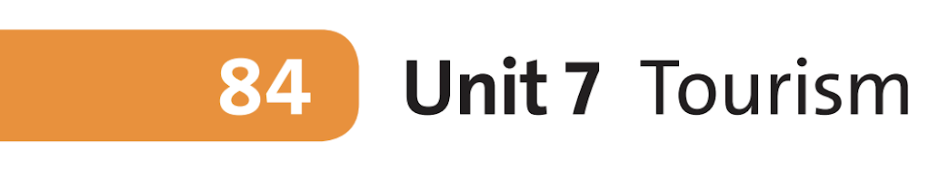
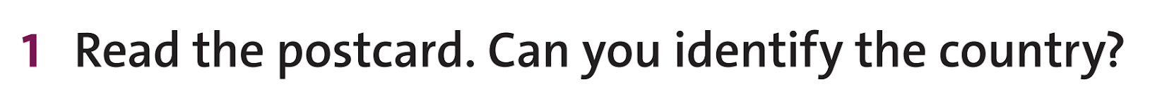
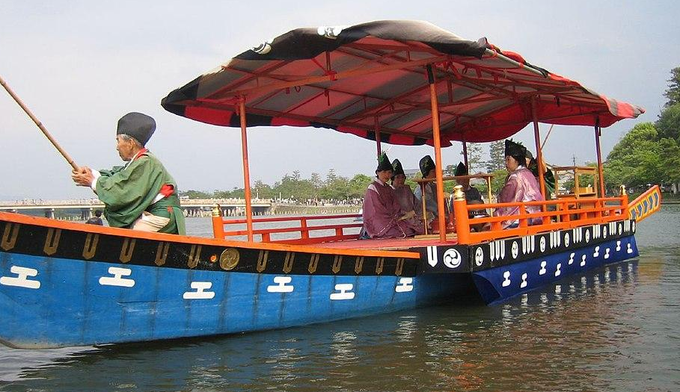
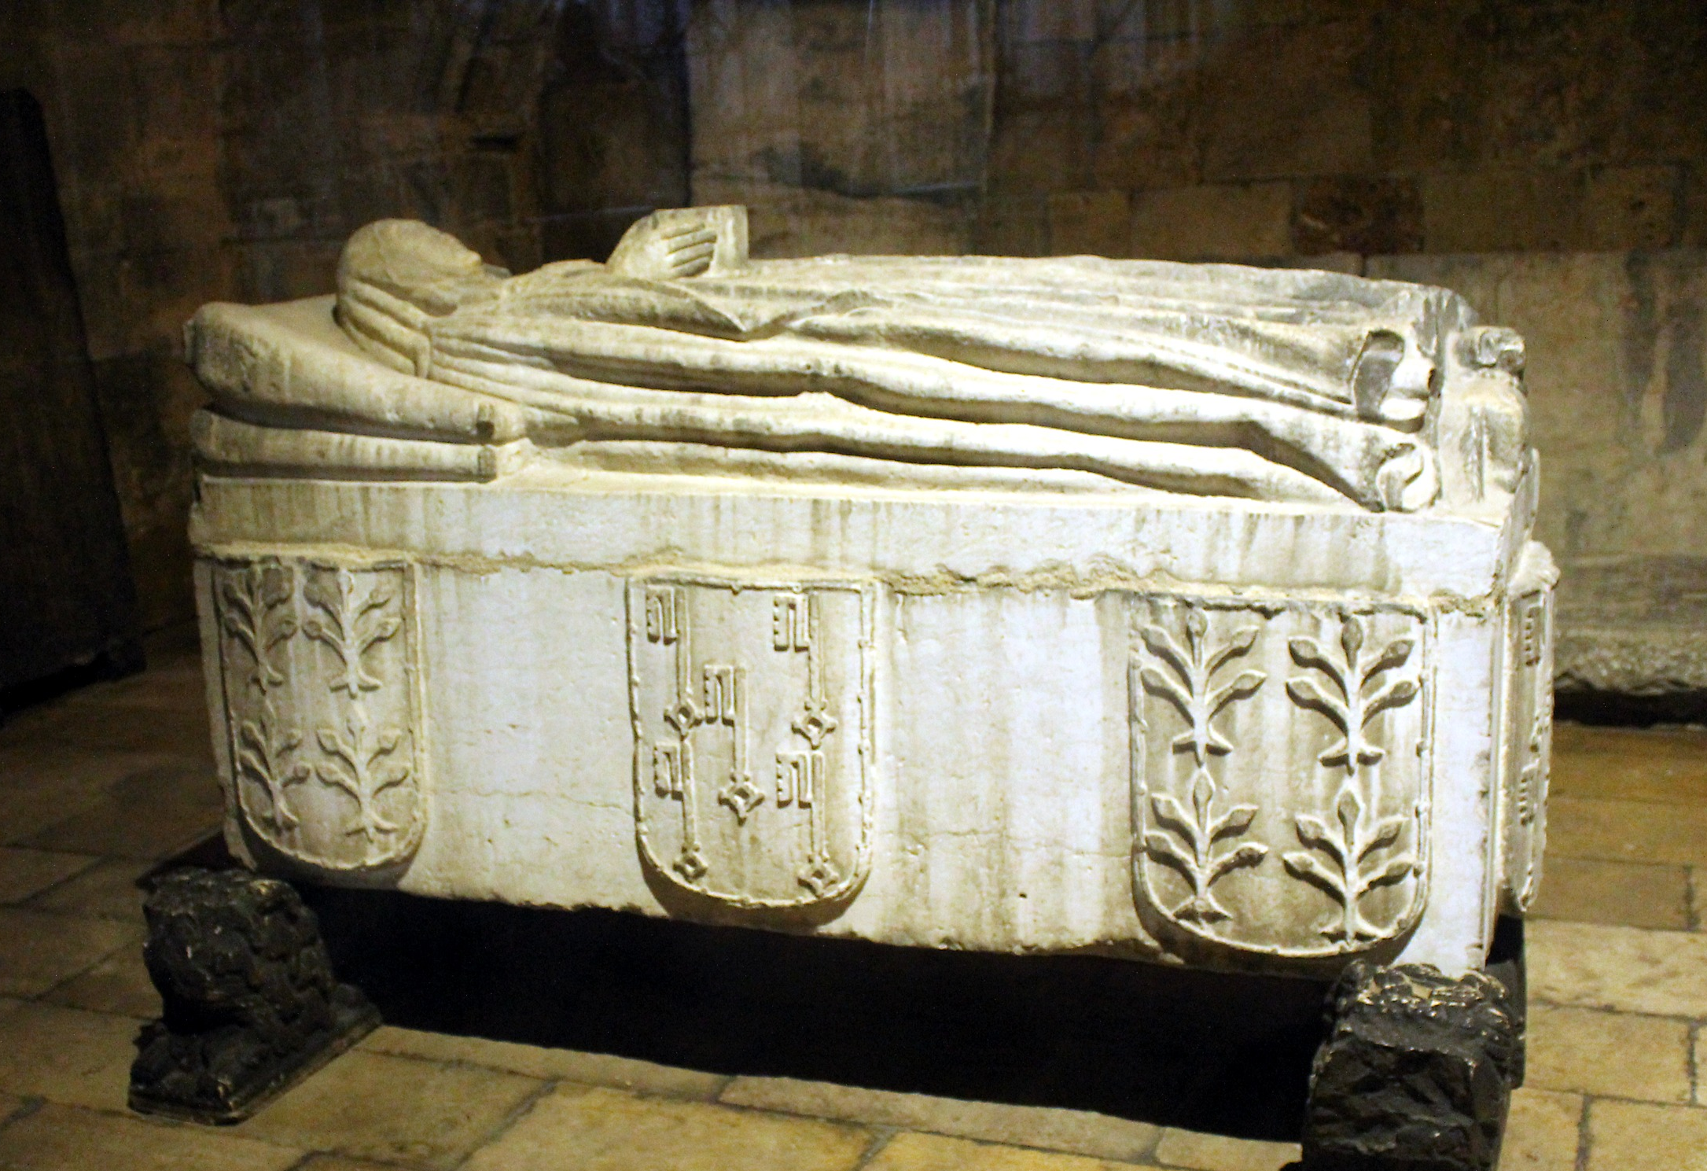
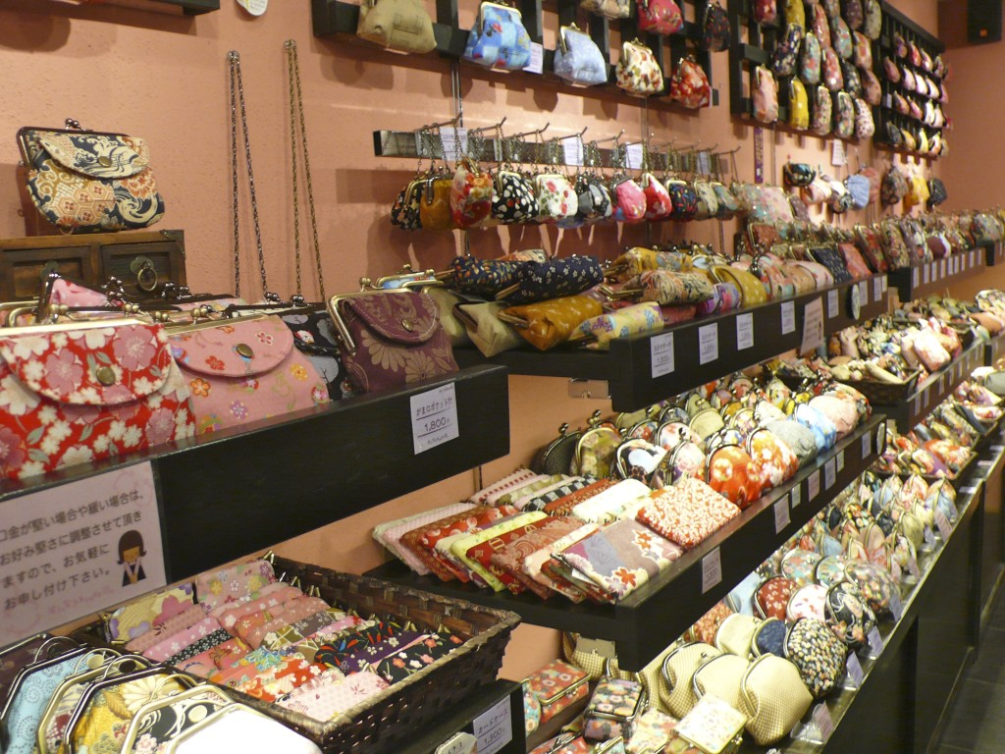

Grammar
This is Hue city – Viet Nam
Boating (n) /ˈbəʊ.tɪŋ/: the activity of travelling on water in a boat for pleasure
Tomb (n) /tuːm/ : a large stone structure or underground room where someone, especially an important person, is buried
Souvenir (n) /ˌsuː.vənˈɪər/: something you buy or keep to help you remember a holiday or special event
www.phuongnam.edu.vn

Slide 11
Grammar
Extra Task: Underline phrases using this structure:
have/ has + past participle
PRESENT PERFECT
www.phuongnam.edu.vn

Slide 12

Grammar
Present Perfect
Positive
Subject + have/has + Past participle(V3)
Negative
Subject + have not/has not + Past participle(V3)
Questions
Have/Has + Subject + Past participle(V3) ?
www.phuongnam.edu.vn

Slide 13
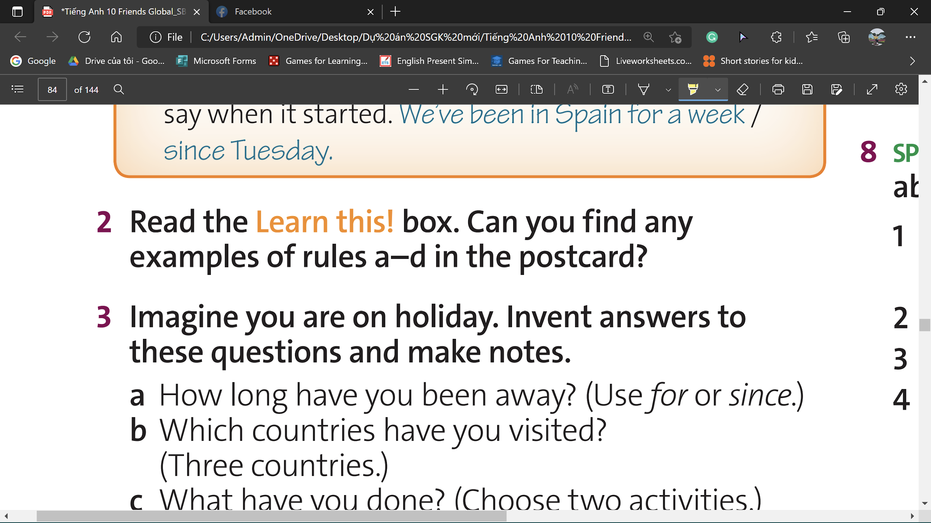
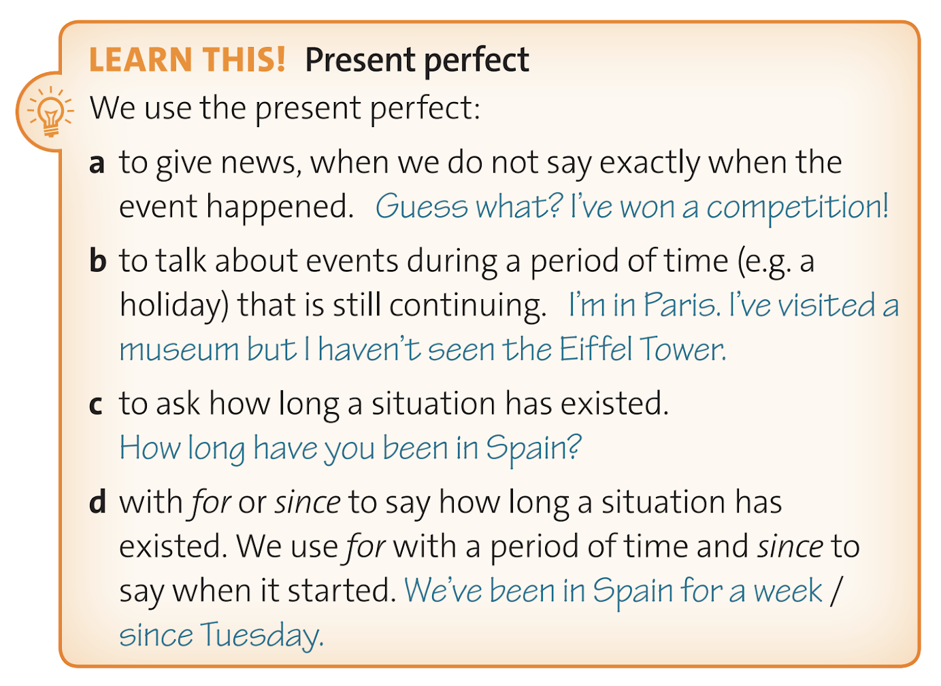

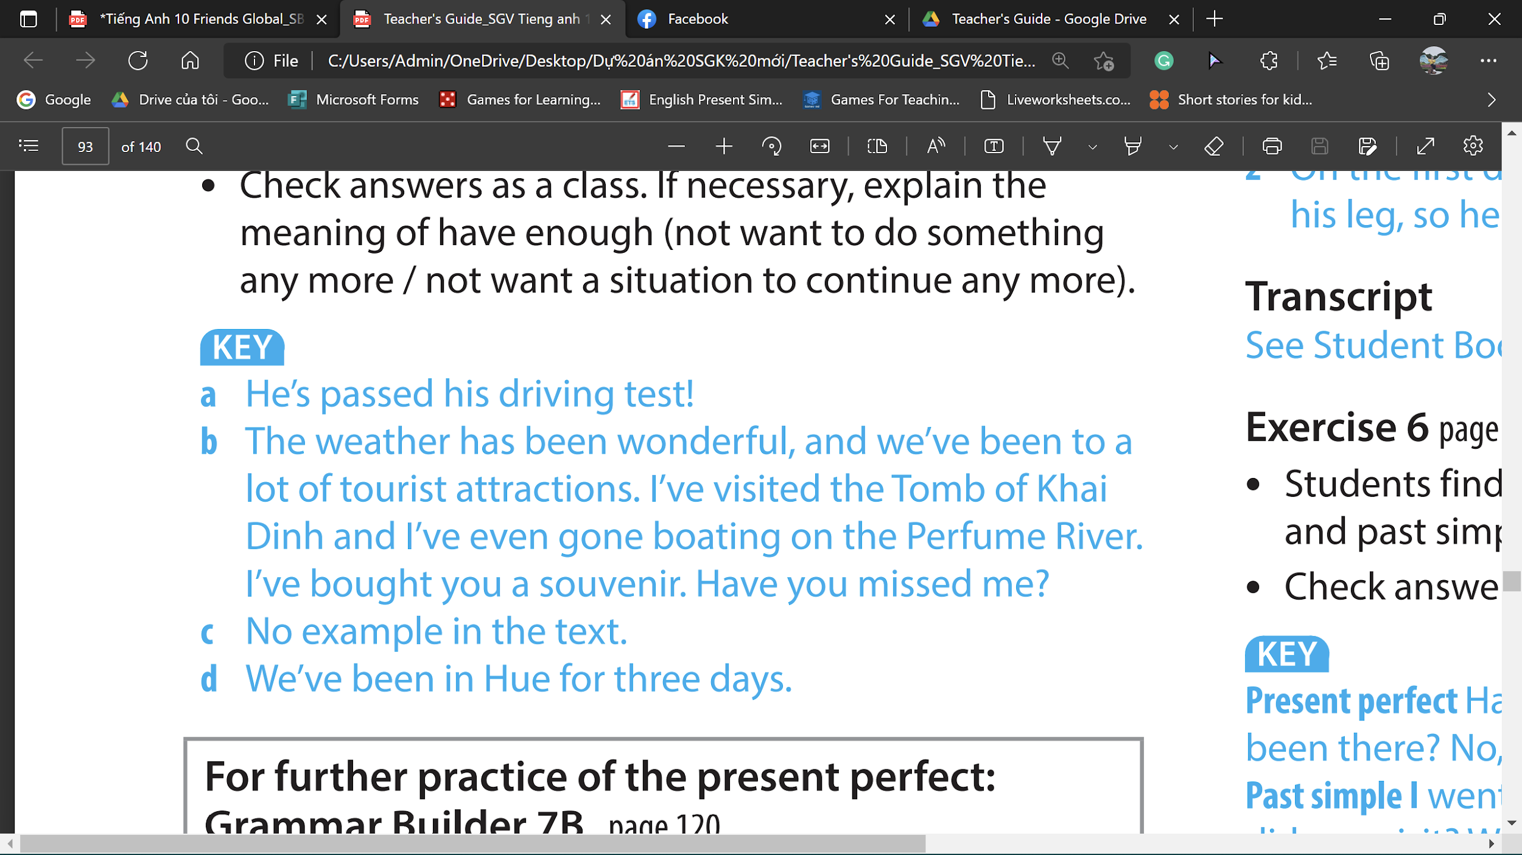
Grammar
www.phuongnam.edu.vn

Slide 14
Grammar
For & Since
A period of Time (How long?)
A specific Date or Time in the Past
Practice:
since
since
since
1. ______ last Sunday.
2. ______ ten years.
3. ______ 2019.
4. ______ he was seven.
5. ______ many hours.
6. ______ Christmas.
7. ______ eight o'clock.
8. ______ a long time.
9. ______ 1980s.
for
for
for
since
since
since
www.phuongnam.edu.vn

Slide 15

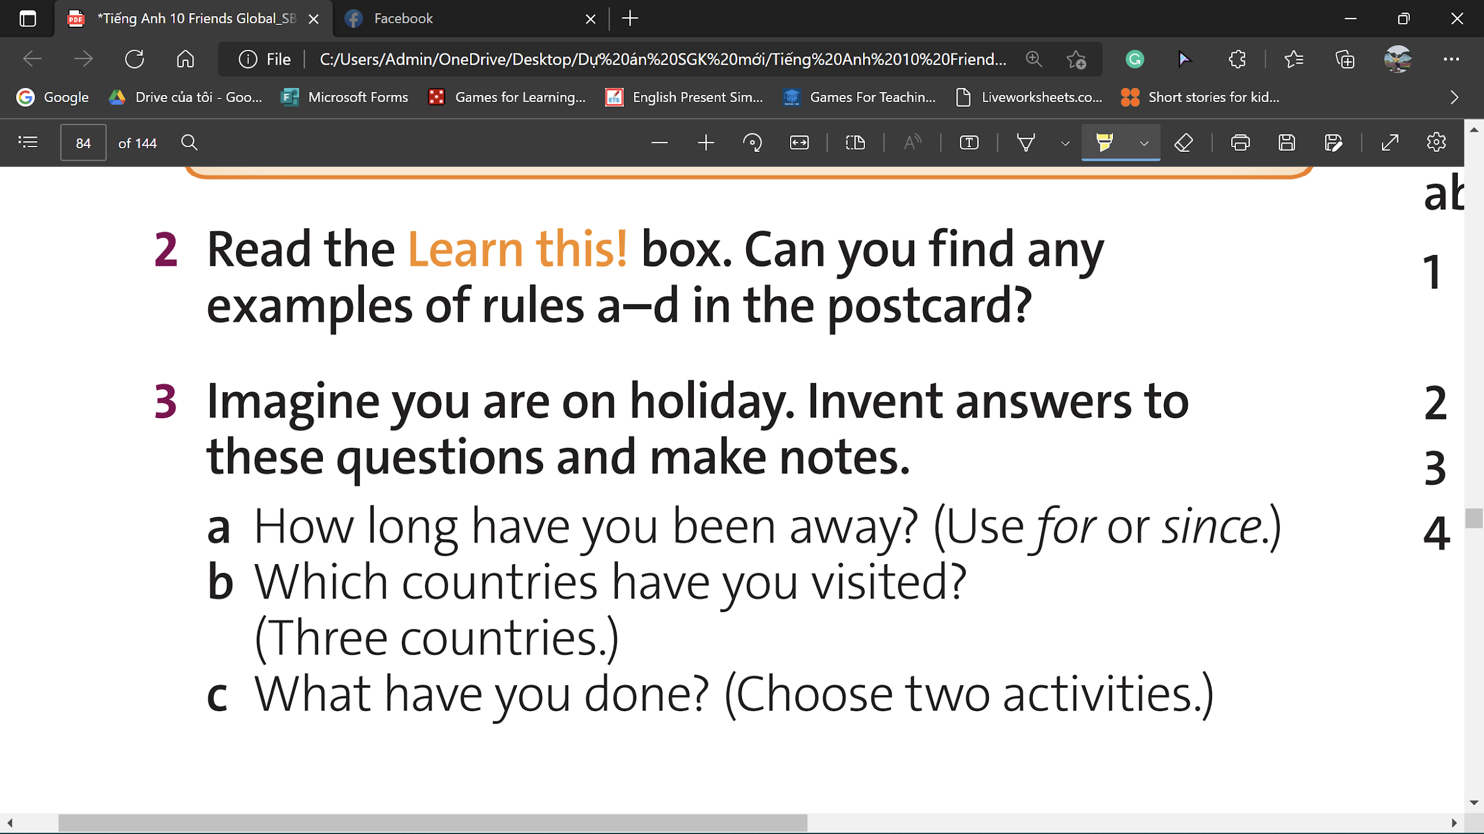


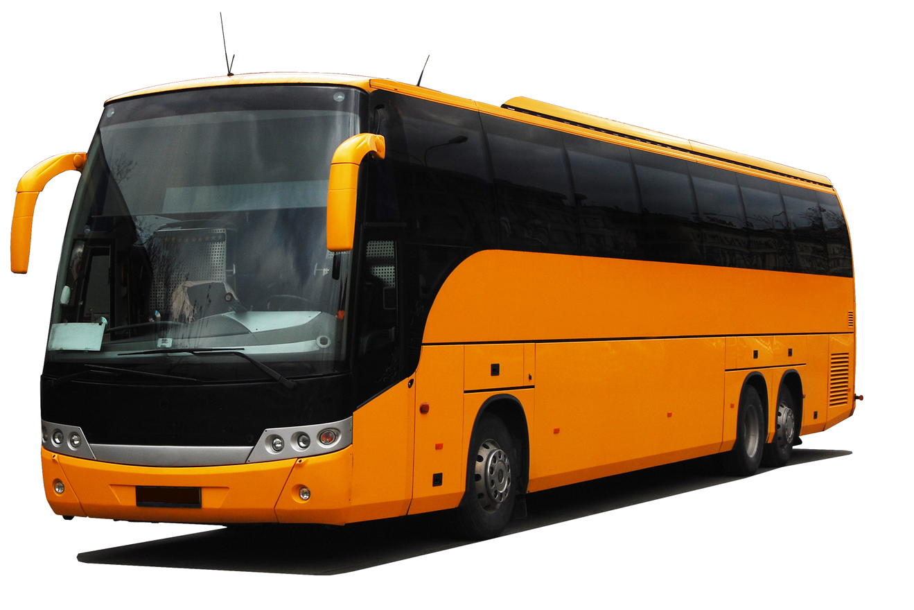
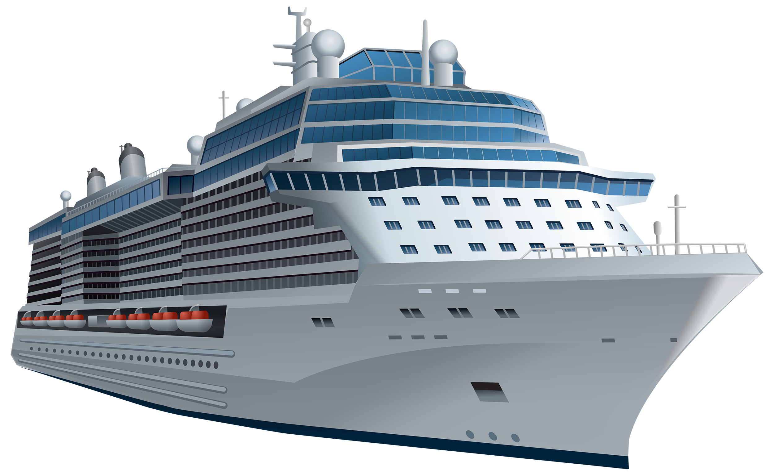
Grammar
www.phuongnam.edu.vn

Slide 16
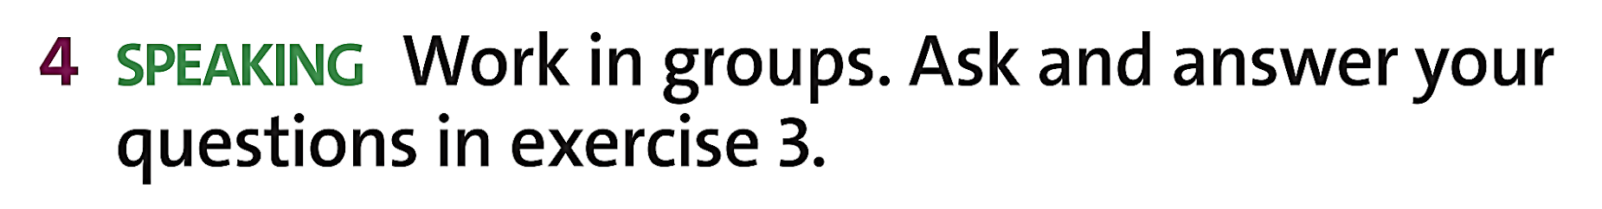

Grammar
I have been in Ha Noi for 2 weeks
I have ridden a horse
I have stayed in Thailand for 1 weeks
I have gone to the beach in Vung Tau
www.phuongnam.edu.vn

Slide 17
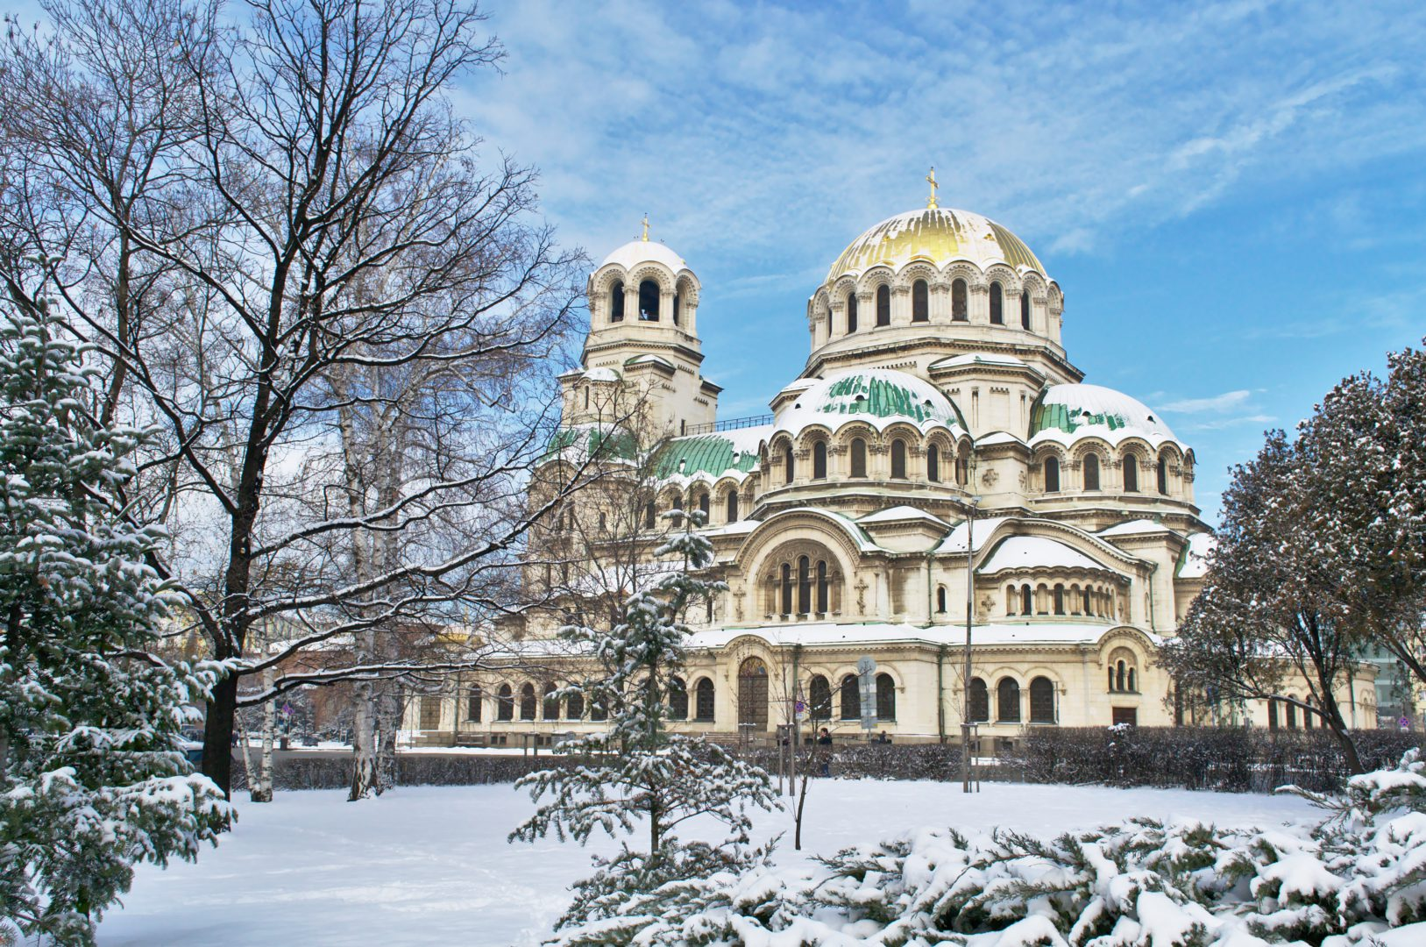
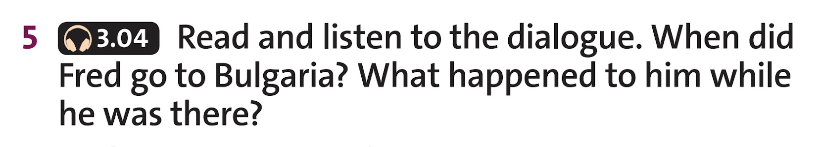

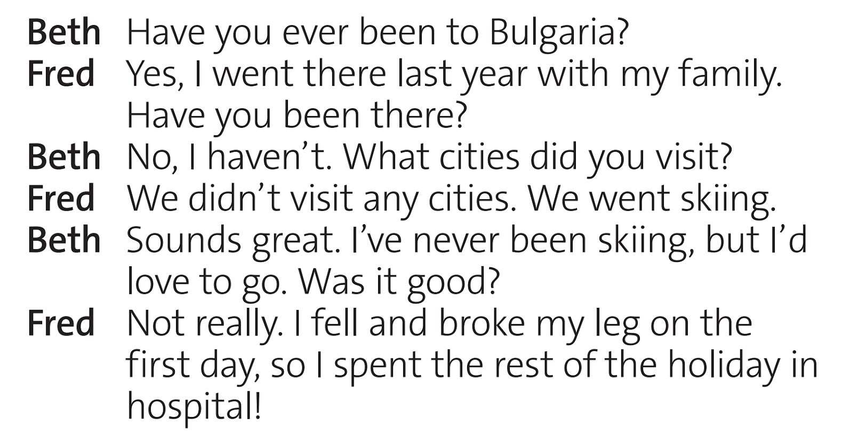
Grammar
1. When did Fred go to Bulgaria?
He went last year.
2. What happened to him while he was there?
On the first day he fell while he was skiing and broke his leg, so he spent the rest of the holiday in hospital.
www.phuongnam.edu.vn

Slide 18
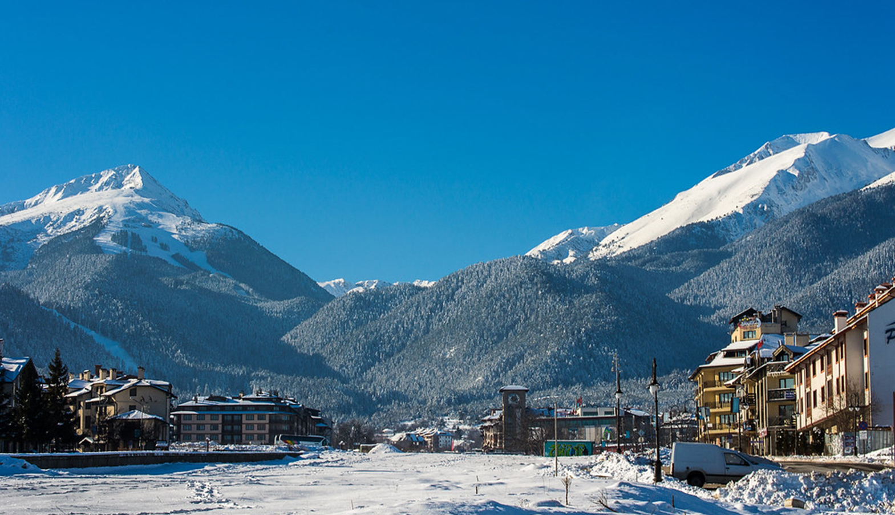

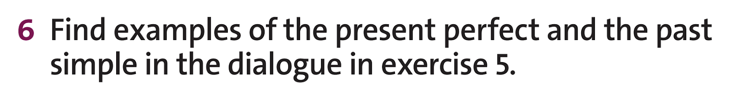
Title:
Grammar
Present Perfect
Past Simple
www.phuongnam.edu.vn

Slide 19
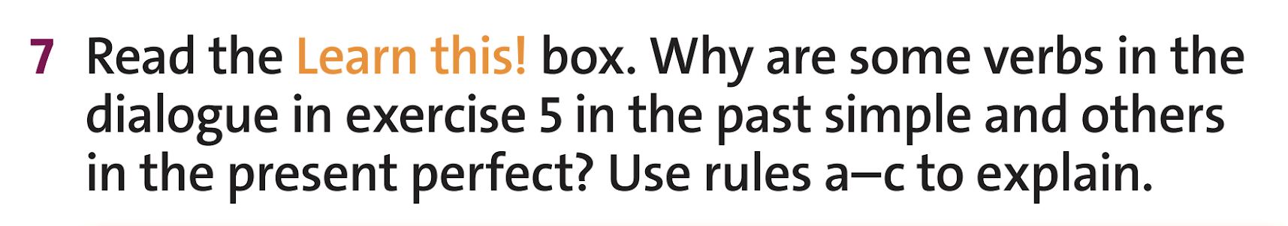

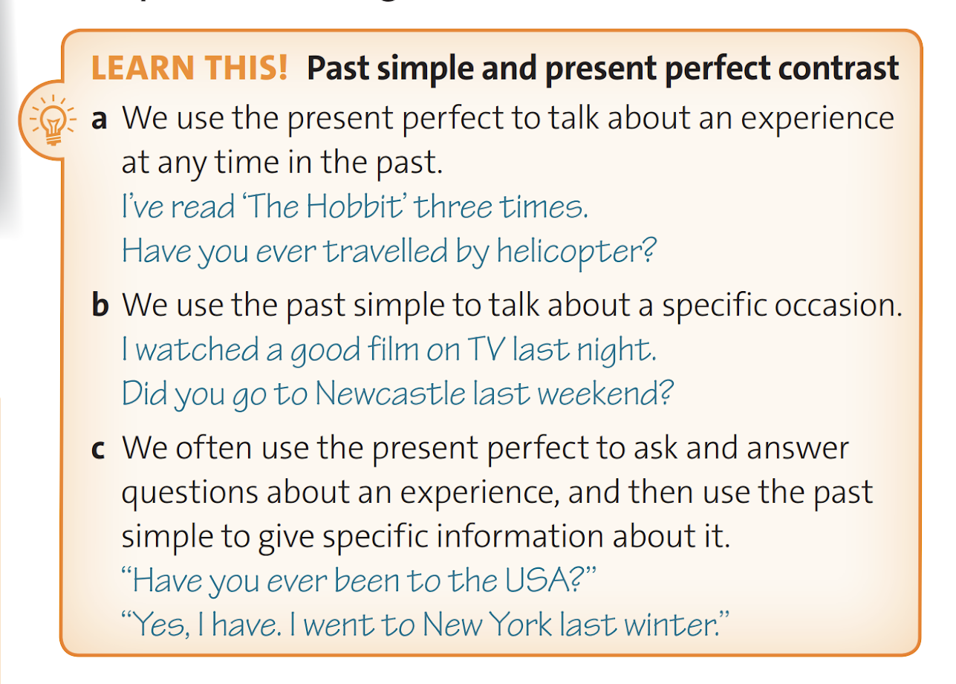
Grammar
Discuss in pairs
The present perfect is used to ask and answer questions.
The past simple is used to give specific information.
www.phuongnam.edu.vn

Slide 20
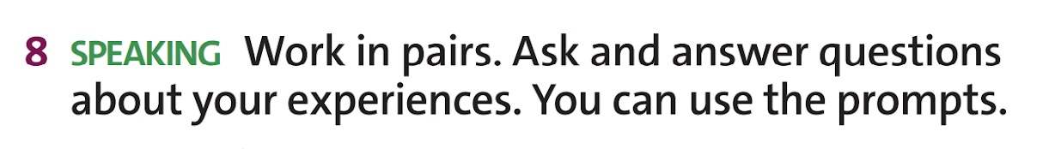


Grammar
Discuss in pairs
Have you ever lost anything while travelling?
Have you ever bought anything online?
Have you ever eaten food from another country?
www.phuongnam.edu.vn

Slide 21
Homework
1. Learn by heart the grammar rules
2. Do exercises in the workbook
3. Prepare U7-C (P.85)
www.phuongnam.edu.vn

Slide 22

www.phuongnam.edu.vn

Slide 23



Thank you!
CTCP ĐẦU TƯ VÀ PHÁT TRIỂN GIÁO DỤC PHƯƠNG NAM

